Slide 1
Lec - 5

Slide 2
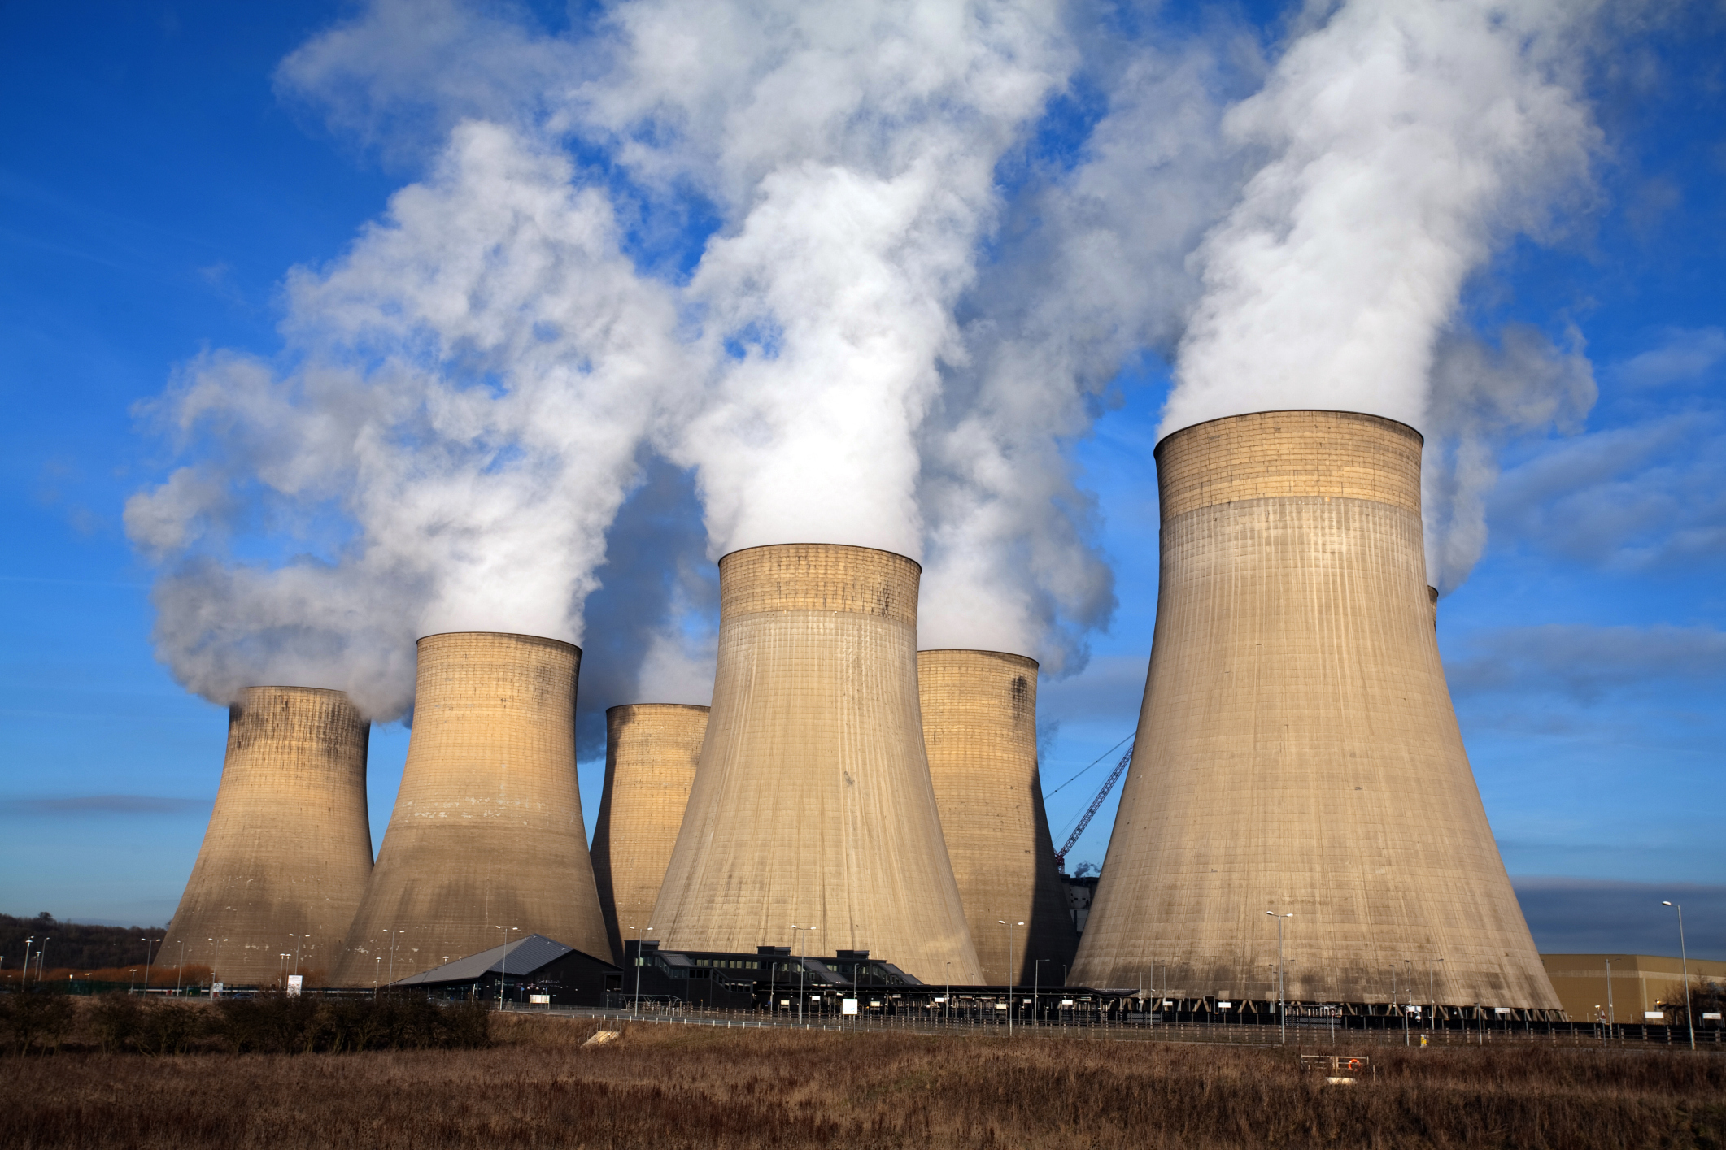
ENERGY – HARNESSED FROM THE NUCLEUS OF AN ATOM
NUCLEAR
ENERGY
NUCLEAR
FISSION
NUCLEAR
FUSION
Splitting up of heavy
nucleus into lighter one
Nuclear fusion is the combination of two lighter nuclei to form heavy nucleus

Slide 3



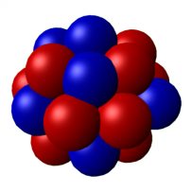


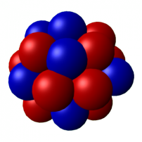
NUCLEAR FISSION
Ba
Uncontrolled
Chain Reactions
The splitting of heavy nucleus of uranium to Barium, krypton and three neutrons with the release of energy is called nuclear fission.
n
Ba
200 MeV
n
ENERGY
Ba
n
n
²³⁵U
n
Kr
n
n
ENERGY
200 MeV
n
ENERGY
Ba
200 MeV
²³⁵U
²³⁶ U
²³⁵U
n
n
n
Kr
Kr
n
ENERGY
200 MeV
²³⁵U
n

Slide 4
NUCLEAR FISSION
Controlled
Chain Reactions
Ba
n
Ba
n
Boron
Ba
n
n
²³⁵U
n
Kr
n
n
Cadmium
Ba
²³⁵U
²³⁵U
n
n
n
Kr
Kr
n
Boron
²³⁵U
n
Kr

Slide 5




Nuclear Power Plant ( Controlled Chain Reaction )
Nuclear reactor
Generator
Boiler
Pump
Turbine
Pump
Condenser

Slide 6
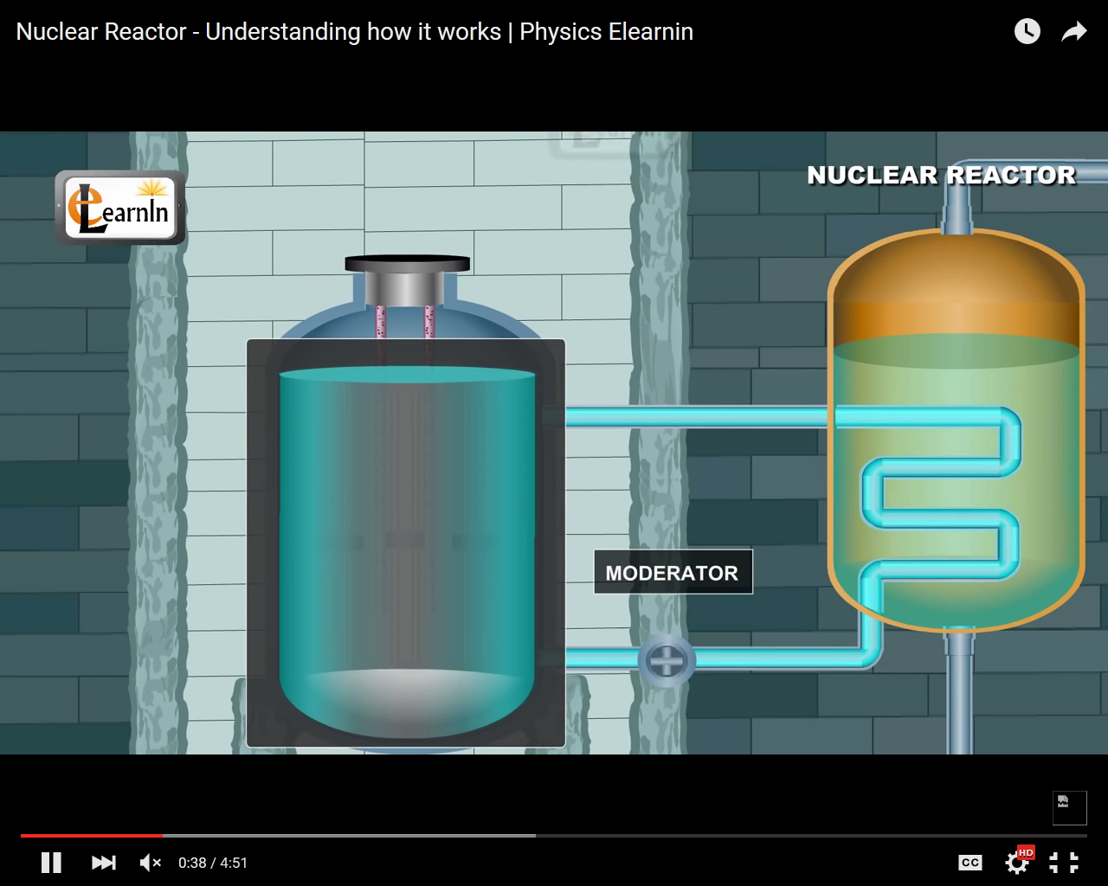
Nuclear Power Plant ( Controlled Chain Reaction )
Three main components
Moderator
Slows down the neutron

Slide 7
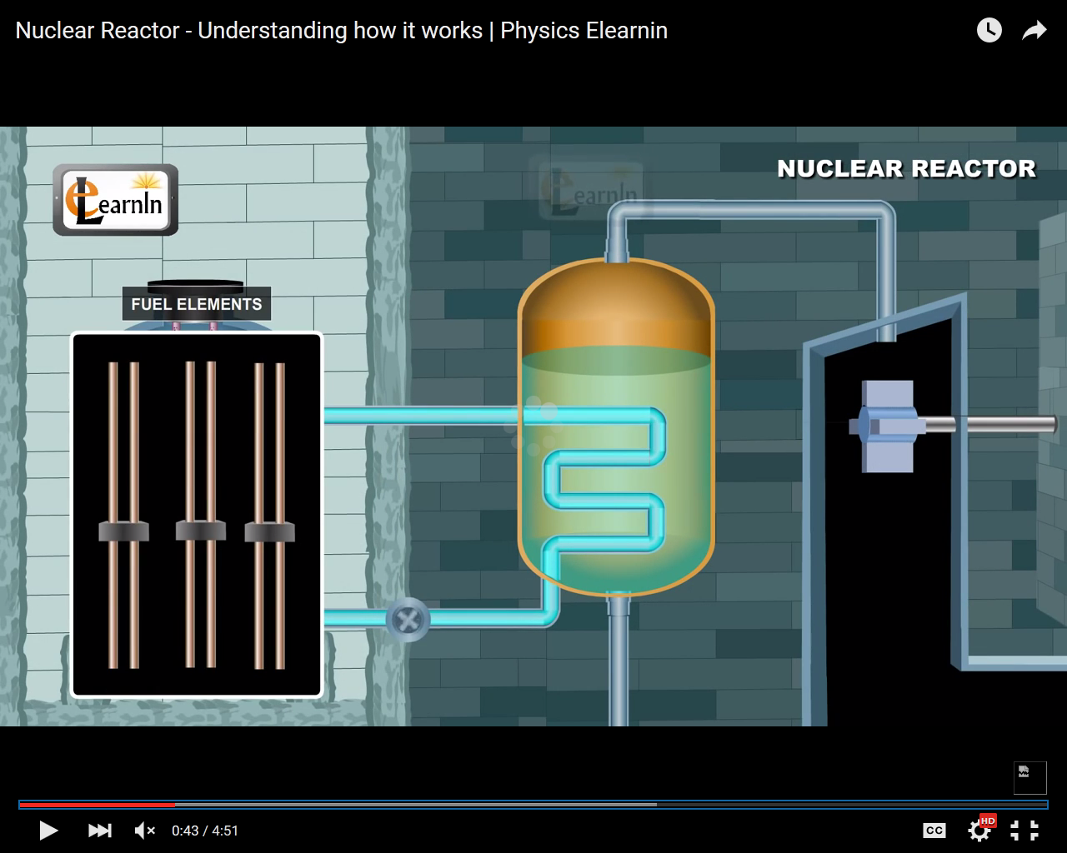
Nuclear Power Plant ( Controlled Chain Reaction )
Fuel elements
FISSIONABLE
Uranium 235

Slide 8
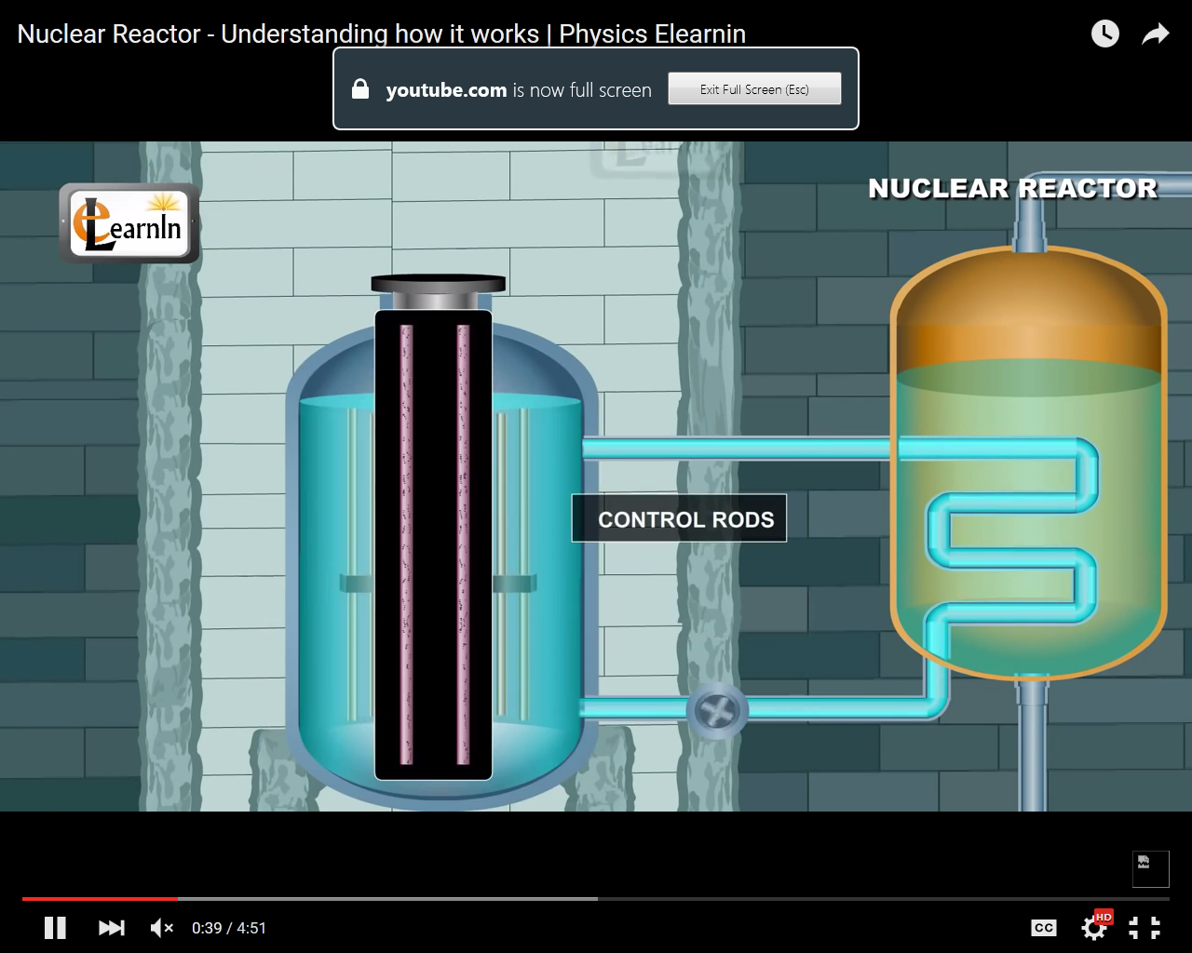
Nuclear Power Plant ( Controlled Chain Reaction )
Control rods
To absorb excess neutrons

Slide 9

Nuclear Power Plant ( Controlled Chain Reaction )
The water in heat exchanger gets heated and converts into steam
Thus electricity is produced.
Nuclear reactor
Generator
N
Boiler
Pump
Cooling
tower
Turbine
S
Warm Water
Pump
Condenser

Slide 10
Nuclear Power Plant ( Controlled Chain Reaction )
Nuclear reactor
for nuclear
fission
System for steam
generation from
water
Nuclear reactor
Generator
Steam turbine
Electrical
energy
Generator
N
Boiler
Pump
Cooling
tower
Turbine
S
Fuel: Uranium or Plutonium
System for conversion of steam back into water
Warm Water
Pump
Condenser

Slide 11
Nuclear Power Plant ( Controlled Chain Reaction )
Kinetic energy
in steam
Kinetic Energy
in turbine
Nuclear
energy
Thermal
energy
Electrical
energy
Nuclear reactor
Generator
N
Boiler
Pump
Cooling
tower
Turbine
S
Warm Water
Pump
Condenser

Slide 12
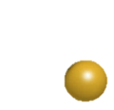
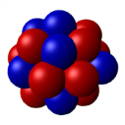
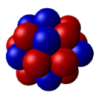
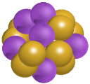



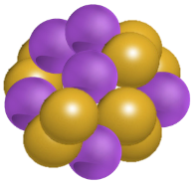



NUCLEAR FUSION
+
+
Energy
Deuterium
Deuterium
Helium Isotope
+
+
Energy
Helium Isotope
Deuterium
Helium
3.3 Mev
18.3 MeV
²
³
⁴
²
Deuterium
²
(₁H)
(₁H)
Helium Isotope
(₂He)
Helium
Deuterium
(₂He)
Deuterium
(₁H)
³
Helium Isotope
(₂He)

Slide 13
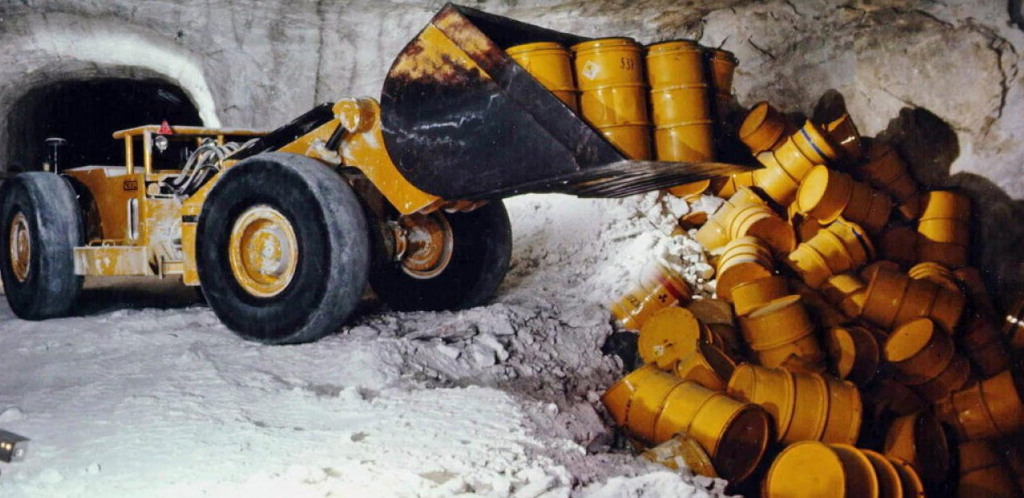
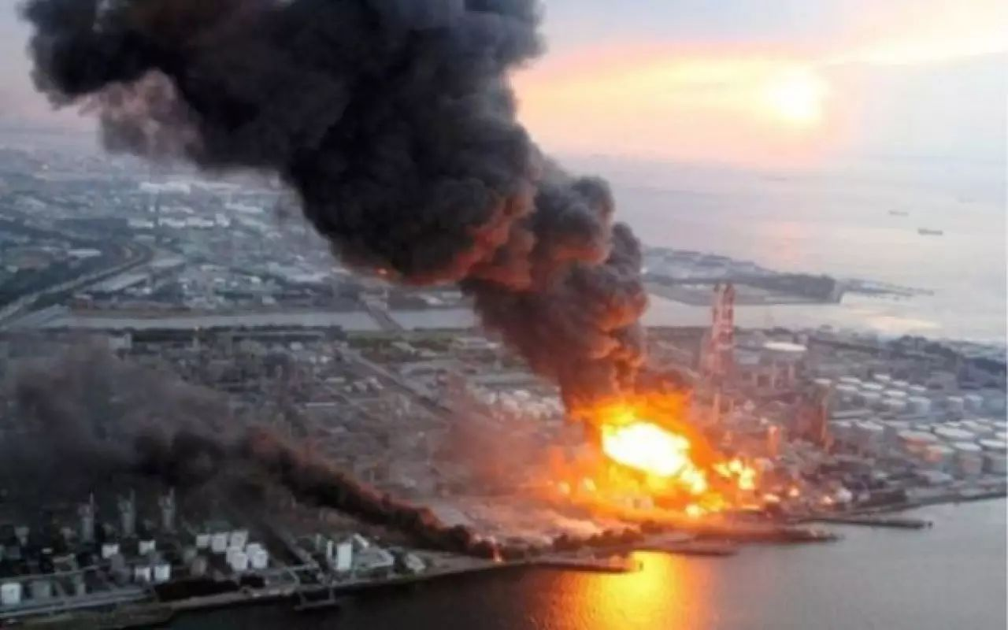

PROBLEMS ASSOCIATED WITH
NUCLEAR POWER PLANT
The products after fission of nuclear fuel are also radioactive and emit harmful radiations, called as nuclear waste.
An accident in nuclear power plant can be very fatal as it may release radiation
Nuclear waste difficult to dispose

Slide 14


Q.
What are the advantages of nuclear energy?
Ans:
Large amount of useful energy from a very small amount of a nuclear fuel.
Continuous generation of Electricity
It does not produce gases like CO₂ which contributes to greenhouse effect or SO₂ which causes acid rain.

Slide 15
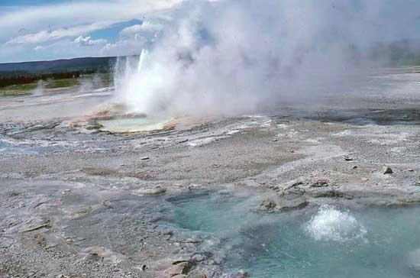
GEOTHERMAL ENERGY
EARTH
HEAT
At some places, molten rocks formed in the deeper hot regions of Earth’s crust are pushed upward and trapped in certain regions known as hot spots.

Slide 16
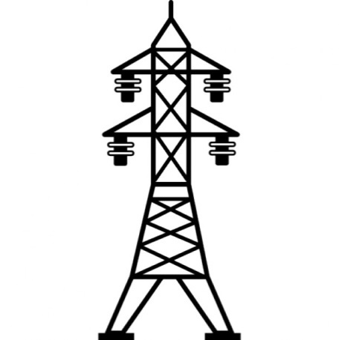


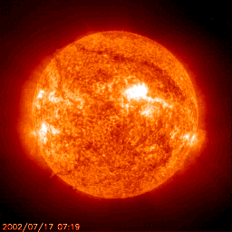
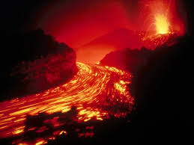
GEOTHERMAL ENERGY
Generator
The rocks present at hot spots, heat the underground water and turn it into steam
UPPERMOST SURFACE
SOIL / STONES
WATER
ROCKS
SPOTS
“MAGMA”
(MOLTENROCKS)

Slide 17

ENVIRONMENTAL CONSEQUENCES
Exploiting any source of energy disturbs the environment in some way.
Factors on which the Source of Energy to be selected
Ease of Extraction of Energy from the Source
Efficiency of the Technology available
1
2
Environmental damage caused
3

Slide 18
Suggest some steps which can be taken to reduce energy consumption.
Q.
Ans:
Switch off lights, fans, TV and other such electrical appliances when not needed, to save electricity.
Use energy efficient electrical appliances to save electricity. This can be done by using compact fluorescent lamps (CFL) and tube - lights in place of conventional filament - type electric bulbs.
Good quality stoves should be used to burn fuels like kerosene and LPG so as to obtain maximum heat.
Pressure cookers should be used for cooking food to save fuel.

Slide 19
What are the environmental consequences of the increasing demand for energy?
Q.
Ans:
The combustion of fossil fuels produces acid rain damaging plants (crops), soil and aquatic life.
The burning of fossil fuels increases the amount of greenhouse in the atmosphere.
Deforestation for obtaining firewood causes soil erosion and destroying wild life.
The construction of hydro - power plants is disturbs ecological balance.

Slide 20
Thank You

